Slide 1

Chapter 8 ~ Image Compression
Heaven’s Light is Our Guide
Department of Computer Science & Engineering
Rajshahi University of Engineering & Technology, Rajshahi-6204, Bangladesh.
S. M. Mahedy Hasan
Assistant Professor, Dept. of CSE
RUET, Rajshahi-6204, Bangladesh.

Slide 2
Image compression
Objective of compression is to reduce amount of data required to represent an image.
It uses the process of removing redundant data.
It transforms the 2D pixel array into statistically uncorrelated dataset and it is known as compression.
Compressed image is reconstructed to get original image or an approximation of the image is known as decompression.
If the reconstructed image is same as original image, it is known as lossless compression.
If the reconstructed image is an approximation of the original image, it is known as lossy compression.

Slide 3
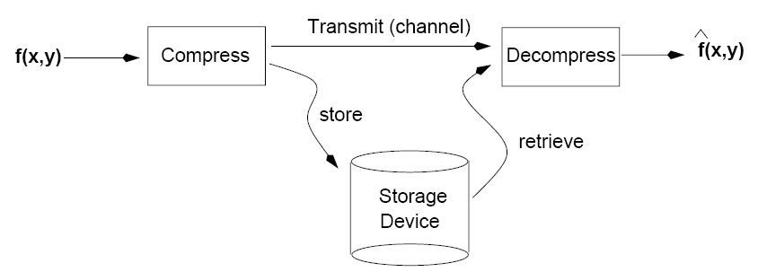
Image Compression

Slide 4
Image Compression Types
Lossless
Information preserving
Low compression ratios
Lossy
Not information preserving
High compression ratios
Trade-off: information loss vs compression ratio

Slide 5
Data Compression
The term data compression refers to the process of reducing the amount of data required to represent a given quantity of information.
In this definition, data and information are not the same; data are the means by which information is conveyed.
Because various amounts of data can be used to represent the same amount of information, representations that contain irrelevant or repeated information are said to contain redundant data.

Slide 6
Data Compression
The same information can be represented by different amount of data – for example:
Your wife, Helen, will meet you at Shah Mukhdam Airport in Rajshahi at 5 minutes past 6:00 pm tomorrow night.
Your wife will meet you at Shah Mukhdam Airport at 5 minutes past 6:00 pm tomorrow night.
Helen will meet you at Shah Mukhdam at 6:00 pm tomorrow night.

Slide 7
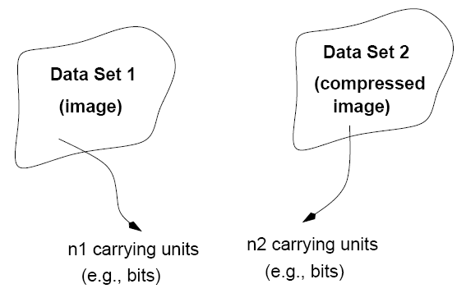
Data Redundancy
Let, n1 and n2 denote the number of information carrying units in two datasets, that represents the same information.
Compression ratio, C = n1/n2 = 100/10 = 10:1
Compression

Slide 8
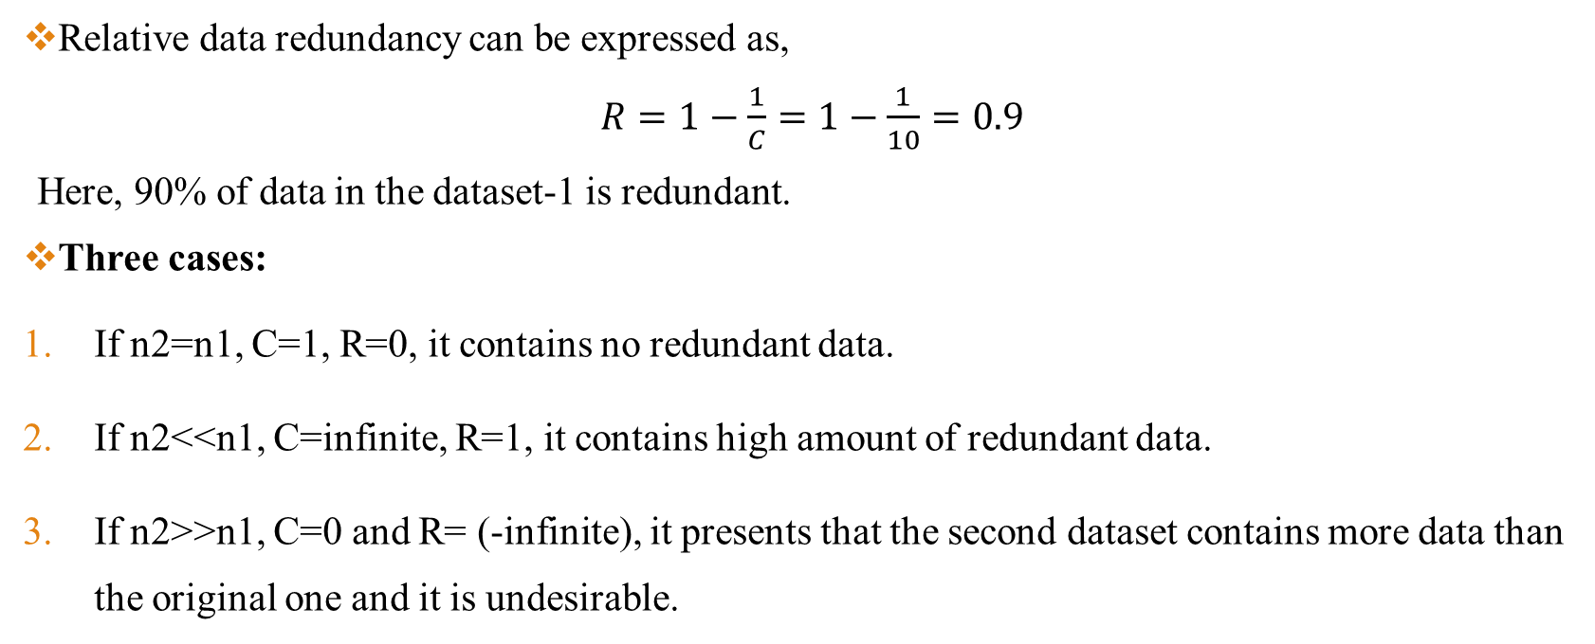
Relative Data Redundancy
Relative data redundancy can be expressed as,
$R=1−\frac{1}{C}=1−\frac{1}{10}=0.9$
Here, 90% of data in the dataset-1 is redundant.
Three cases:
If n2=n1, C=1, R=0, it contains no redundant data.
If n2<<n1, C=infinite, R=1, it contains high amount of redundant data.
If n2>>n1, C=0 and R= (-infinite), it presents that the second dataset contains more data than the original one and it is undesirable.

Slide 9
Types of Redundancy
Data compression is achieved when one or more of these redundancies are reduced or eliminated.
Redundancy
Coding Redundancy
Interpixel Redundancy
Psycho-visual Redundancy

Slide 10
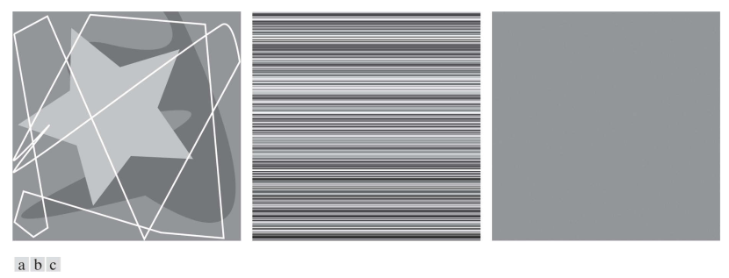
Types of Redundancy
Figure 1: Computer generated bit images with (a) coding redundancy, (b) inter-pixel redundancy, and (c) psycho-visual redundancy.

Slide 11
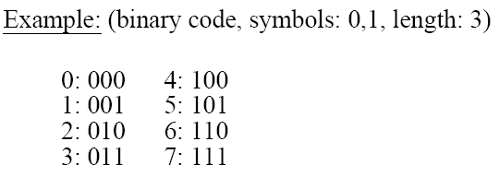
Coding Redundancy
Code: a list of symbols (letters, numbers, bits etc.)
Code word: a sequence of symbols used to represent some information (e.g., gray levels).
Code word length: number of symbols in a code word.
Use short code words instead of long ones.
Can use variable length codes, so that most common values have shortest codes.

Slide 12
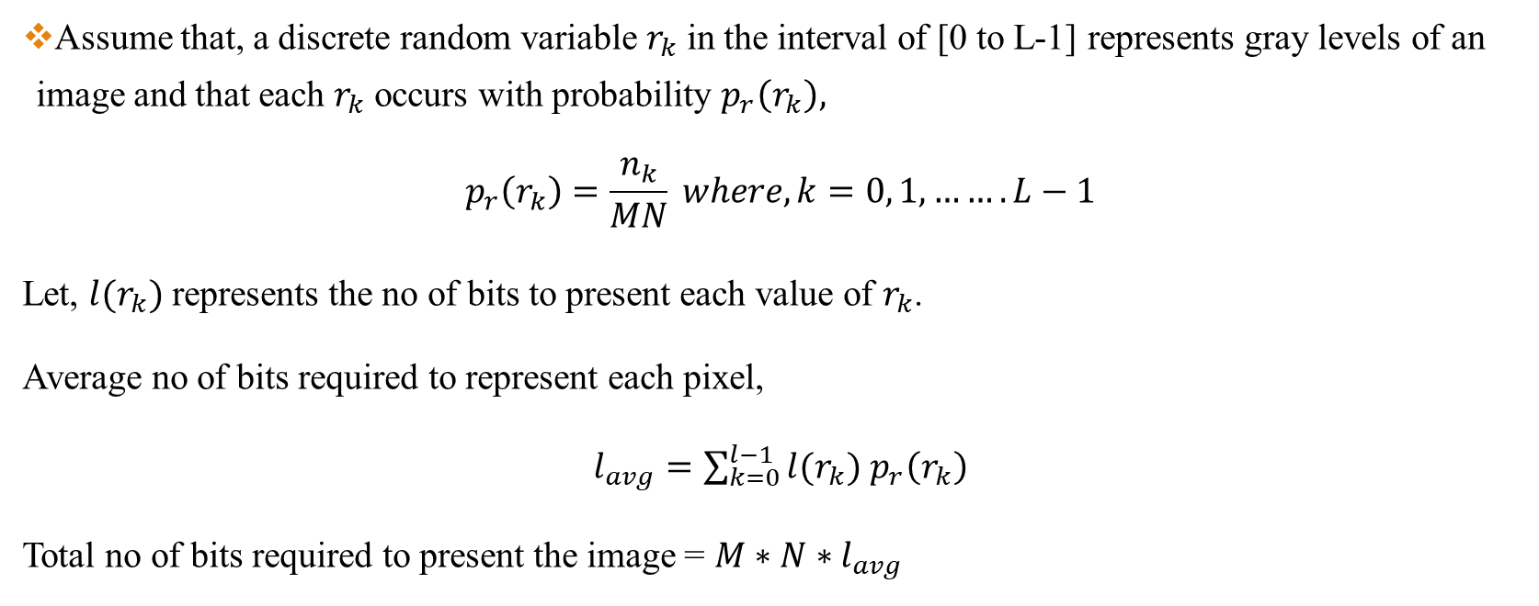
Coding Redundancy
Assume that, a discrete random variable $r_{k}$ in the interval of [0 to L-1] represents gray levels of an image and that each $r_{k}$ occurs with probability $p_{r}\left(r_{k}\right),$
$$p_{r}\left(r_{k}\right)=\frac{n_{k}}{MN} where, k=0, 1, …….L−1$$
Let, $l(r_{k})$ represents the no of bits to present each value of $r_{k}$.
Average no of bits required to represent each pixel,
$l_{avg}=\sum_{k=0}^{l−1}{l(r_{k})}$ $p_{r}\left(r_{k}\right)$
Total no of bits required to present the image = $M∗N∗l_{avg}$

Slide 13
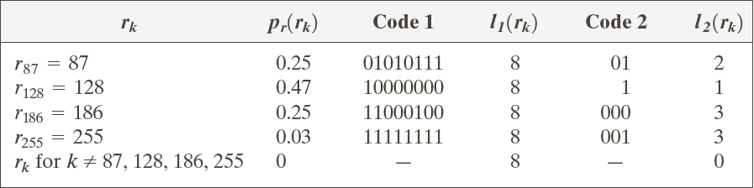
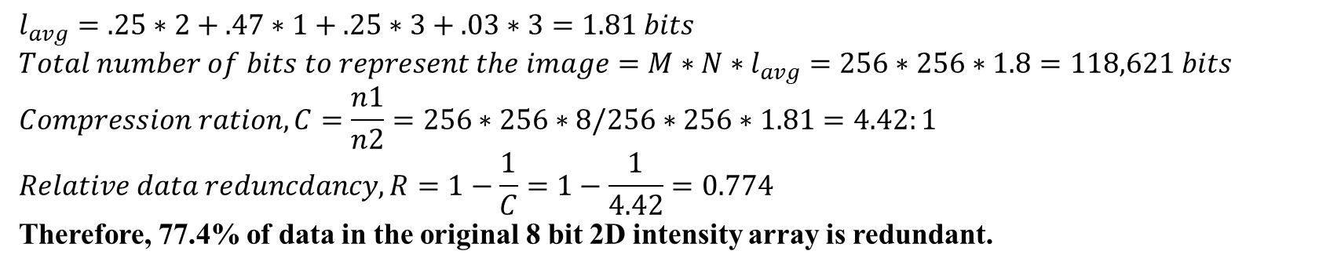
Coding Redundancy
Let us consider an example,
$$l_{avg}=.25∗2+.47∗1+.25∗3+.03∗3=1.81 bits$$
$$Total number of bits to represent the image=M∗N∗l_{avg}=256∗256∗1.8=118,621 bits$$
$$Compression ration, C=\frac{n1}{n2}=256∗256∗8/256∗256∗1.81=4.42:1$$
$$Relative data reduncdancy, R=1−\frac{1}{C}=1−\frac{1}{4.42}=0.774$$
Therefore, 77.4% of data in the original 8 bit 2D intensity array is redundant.

Slide 14
Coding Redundancy
Key Points:
As the preceding example shows, coding redundancy is present when the codes assigned to a set of events (such as intensity values) do not take full advantage of the probabilities of the events.
Coding redundancy is almost always present when the intensities of an image are represented using a natural binary code.
The natural consequence is that, for most images, certain intensities are more probable than others (that is, the histograms of most images are not uniform). A natural binary encoding assigns the same number of bits to both the most and least probable values, failing to minimize, and resulting in coding redundancy.

Slide 15
Interpixel Redundancy
Due to correlation between neighboring pixels in an image.
Any pixel value can reasonably predicted by its neighbors.
Parts of an images are highly correlated. We can predict a given pixel from its neighbor.
Consider the computer-generated collection of constant intensity lines in Fig.1(b) . In the corresponding 2-D intensity array:
All 256 intensities are equally probable. As Fig. 2 shows, the histogram of the image is uniform.
Because the intensity of each line was selected randomly, its pixels are independent of one another in the vertical direction.
Because the pixels along each line are identical, they are maximally correlated (completely dependent on one another) in the horizontal direction.

Slide 16
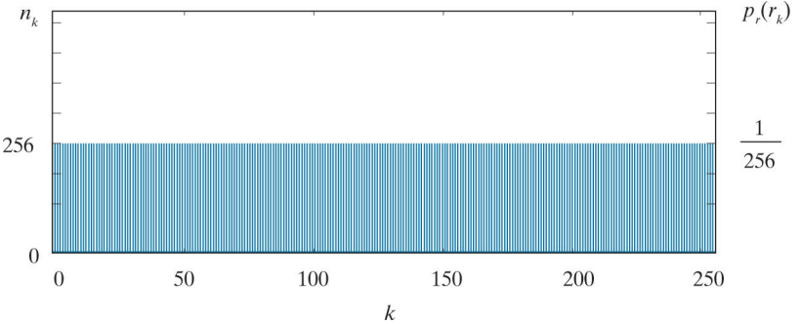
Interpixel Redundancy
Figure 2: The intensity histogram of the image in Fig.1(b)

Slide 17
Psycho-Visual Redundancy
One of the simplest ways to compress a set of data is to remove superfluous data from the set.
In the context of digital image compression, information that is ignored by the human visual system, or is extraneous to the intended use of an image, are obvious candidates for omission.
Thus, the computer-generated image in Fig. 1(c) , because it appears to be a homogeneous field of gray, can be represented by its average intensity alone—a single 8-bit value.
The original bit intensity array is reduced to a single byte, and the resulting compression is(256*256*8)/8 or 65,536:1.
Of course, the original bit image must be recreated to view and/or analyze it, but there would be little or no perceived decrease in reconstructed image quality.

Slide 18
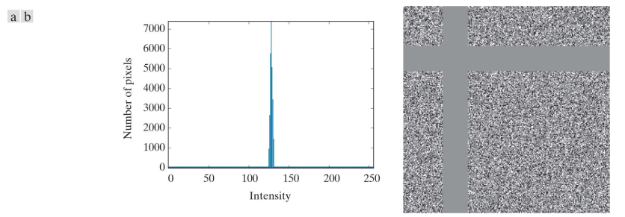
Psycho-Visual Redundancy
Figure 3: (a) Histogram of the image in Fig. 1(c) and (b) a histogram equalized version of the image

Slide 19
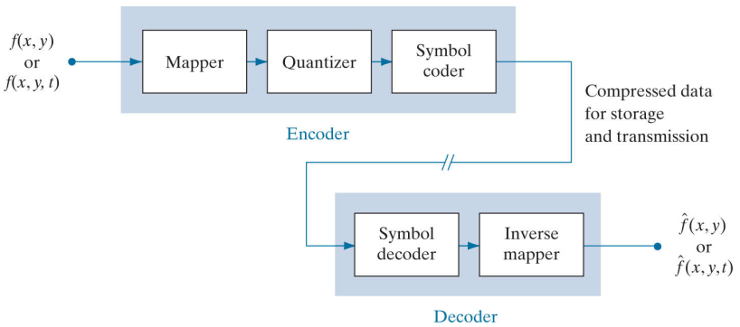
Image Compression Model
Figure 4: Functional block diagram of a general image compression system

Slide 20
Image Compression Model
The encoder of Fig. 4 is designed to remove the redundancies described in the previous sections through a series of three independent operations.
In the first stage of the encoding process, a mapper transforms f(x, …) into a (usually nonvisual) format designed to reduce spatial and temporal redundancy.
This operation generally is reversible, and may or may not directly reduce the amount of data required to represent the image.
Run-length coding is an example of a mapping that normally yields compression in the first step of the encoding process.

Slide 21
Image Compression Model
The quantizer in Fig. 4 reduces the accuracy of the mapper’s output in accordance with a pre-established fidelity criterion.
The goal is to keep irrelevant information out of the compressed representation. As noted earlier, this operation is irreversible.
It must be omitted when error-free compression is desired.

Slide 22
Image Compression Model
In the third and final stage of the encoding process, the symbol coder of Fig. 4 generates a fixed-length or variable-length code to represent the quantizer output, and maps the output in accordance with the code.
In many cases, a variable-length code is used.
The shortest code words are assigned to the most frequently occurring quantizer output values, thus minimizing coding redundancy.
This operation is reversible. Upon its completion, the input image has been processed for the removal of each of the three redundancies described in the previous sections.

Slide 23
Image Decompression Model
The decoder of Fig. 4 contains only two components: a symbol decoder and an inverse mapper.
They perform, in reverse order, the inverse operations of the encoder’s symbol encoder and mapper.
Because quantization results in irreversible information loss, an inverse quantizer block is not included in the general decoder model.

Slide 24
Lossless vs Lossy Compression
Lossless, f(x,y)
Mapper
Symbol Encoder
Source Encoder
Lossy, f(x,y)
Mapper
Quantizer
Symbol Encoder
Source Encoder

Slide 25
Huffman Coding
Takes advantage of coding redundancy.
Generates a variable length code, as close as possible to the theoretical minimum length.
Doesn’t take advantage of inter-pixel redundancy.
Widely used as a component (the symbol coder) in many compression methods.
Algorithm:
Find the gray level probabilities
Order the probabilities, from smallest to largest
Combine the smallest two by addition
Repeat steps 2-3 until only two probabilities are left
By working backward along the tree, generate code by alternating assignment of 0 and 1

Slide 26
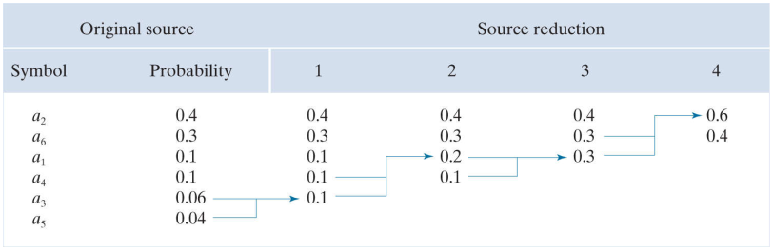
Huffman Coding
Symbols | a1 | a2 | a3 | a4 | a5 | a6
Probability | 0.1 | 0.4 | 0.06 | 0.1 | 0.04 | 0.3

Slide 27
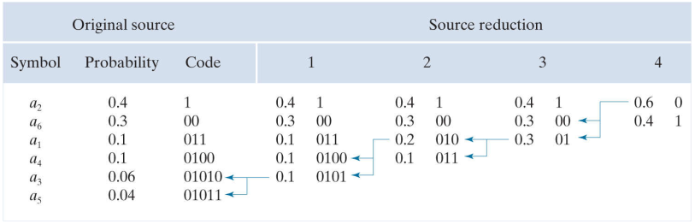
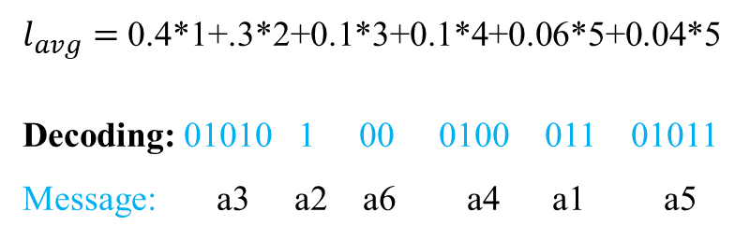
Huffman Encoding
$l_{avg}=$ 0.4*1+.3*2+0.1*3+0.1*4+0.06*5+0.04*5
Decoding: 01010 1 00 0100 011 01011
Message: a3 a2 a6 a4 a1 a5

Slide 28
Arithmetic Coding
The main weakness of Huffman coding is that it encodes source symbols one at a time.
Arithmetic coding encodes sequences of source symbols together.
There is no one-to-one correspondence between source symbols and code words.
Slower than Huffman coding but can achieve better compression.
A sequence of values is assigned a single arithmetic code word.
The code word is a fractional number between 0 and 1 (e.g., 0.4731).
Each symbol is assigned an interval based on its probability of occurrence.
Code words are fixed length.

Slide 29
Arithmetic Coding
Example:
Source Symbol | Probability | Initial Subinterval
a1 | 0.2 | [0.0, 0.2)
a2 | 0.2 | [0.2, 0.4)
a3 | 0.4 | [0.4, 0.8)
a4 | 0.2 | [0.8, 1.0)

Slide 30
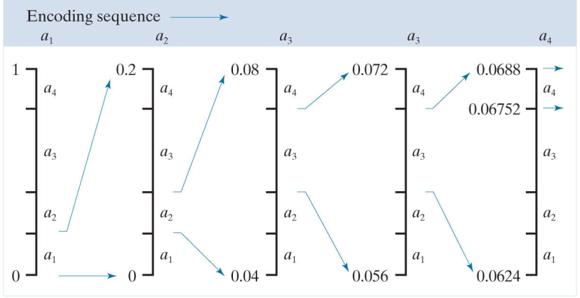
Arithmetic Coding
Of course, any number within this subinterval [0.06752, 0.0688) , for example, 0.068, can be used to represent the message.

Slide 31
LZW Coding (Dictionary-Based Coding)
It is known as Limpel - Ziv - Welch coding.
It focuses on interpixel redundancy.
It assigns fixed length code words to the variable length sequences.
Requires no prior knowledge of symbol probabilities.
A codebook (or dictionary) needs to be constructed.
Initially, the first 256 entries of the dictionary are assigned to the gray levels 0,1,2,..,255 (i.e., assuming 8 bits/pixel).
Initial Dictionary
Dictionary Location Entry
0 0
1 1
. .
255 255
256 -
511 -

Slide 32
LZW Coding (Dictionary-Based Coding)
Example: Consider a 4x4, 8 bit image and compress it using LZW coding,
39 | 39 | 126 | 126
39 | 39 | 126 | 126
39 | 39 | 126 | 126
39 | 39 | 126 | 126
Original image

Slide 33
LZW Coding (Dictionary-Based Coding)
Currently Recognized Sequence | Pixel Being Processed | Encoded Output | Dictionary Location (Code Word) | Dictionary Entry
- | 39
39 | 39 | 39 | 256 | 39–39
39 | 126 | 39 | 257 | 39–126
126 | 126 | 126 | 258 | 126–126
126 | 39 | 126 | 259 | 126–39
39 | 39
39–39 | 126 | 256 | 260 | 39–39–126
126 | 126
126–126 | 39 | 258 | 261 | 126–126–39
39 | 39
39-39 | 126
39–39–126 | 126 | 260 | 262 | 39–39–126–126
126 | 39
126-39 | 39 | 259 | 263 | 126–39–39
39 | 126
39-126 | 126 | 257 | 264 | 39–126–126
126 |  | 126

Slide 34
LZW Decoding (Dictionary-Based Coding)
Dictionary Index | Entry
0 | 0
1 | 1
: | :
255 | 255
256 | 39-39
257 | 39-126
258 | 126-126
259 | 126-39
260 | 39-39-126
261 | 126-126-39
262 | 39-39-126-126
263 | 126-39-39
264 | 39-126-126
Encoded Sequence
39 39 126 126 256 258 260 259 257 126
Final Dictionary

Slide 35
LZW Decoding (Dictionary-Based Coding)
Currently Recognized Sequence | Pixel Being Processed | Encoded Output | Dictionary Location (Code Word) | Dictionary Entry
 | 39
39 | 39 | 39 | 256 | 39-39
39 | 126 | 39 | 257 | 39-126
126 | 126 | 126 | 258 | 126-126
126 | 256 | 126 | 259 | 126-39
256 | 258 | 39-39 | 260 | 39-39-126
258 | 260 | 126-126 | 261 | 126-126-39
260 | 259 | 39-39-126 | 262 | 39-39-126-126
259 | 257 | 126-39 | 263 | 126-39-39
257 | 126 | 39-126 | 264 | 39-126-126
126 |  | 126

Slide 36
Run Length Coding (RLC)
Reduce the size of a repeating string of symbols.
Encodes a run of symbols into two bytes: (symbol, count).
1 1 1 1 1 0 0 0 0 0 0 1 → (1,5) (0, 6) (1, 1)
a a a b b b b b b c c → (a,3) (b, 6) (c, 2)
Can compress any type of data but cannot achieve high compression ratios compared to other compression methods.

Slide 37
Run Length Coding (RLC)
It reduces interpixel redundancy.
Generally, it works well for binary images.
1st row = (0,5)
2nd row = (0,3),(1,2)
3rd row = (1,5)
4th row = (1,5)
5th row = (1,5)
Total vectors = 6
Max length = 5
Total no. of bits = 6* (3 ( no. of bits to represent length) + 1 (no. of bits to represent pixels)) = 24
0 | 0 | 0 | 0 | 0
0 | 0 | 0 | 1 | 1
1 | 1 | 1 | 1 | 1
1 | 1 | 1 | 1 | 1
1 | 1 | 1 | 1 | 1
Image
5 x 5
Encoded data: 0101 0011 1010 1101 1101 1101

Slide 38
Run Length Coding (RLC)
1 | 1 | 1 | 1
1 | 2 | 2 | 2
2 | 4 | 4 | 4
5 | 6 | 7 | 7
Original Image
RLC = (1,5), (2,4), (4,3), (5,1), (6,1), (7,2)
Total no. of bits = 6 * (3+3) = 36 bits
Binary RLC = (001, 101), (010, 100), (100,011), (101,001), (110,001), (111,010)

Slide 39
Thank You ☺

